Slide 1
Types of Radiation

Slide 2
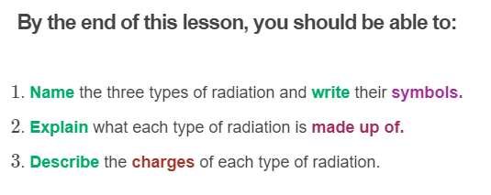

Slide 3
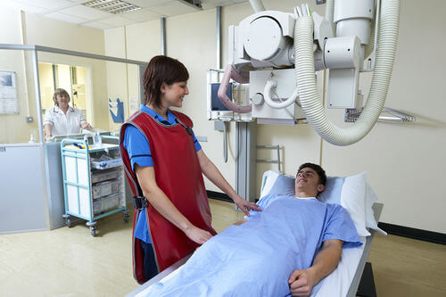
When radioactive isotopes decay, they release radiation from their nuclei.
There are three different types of radiation that can be released: alpha, beta and gamma radiation.
These types of radiation can be harmful, but we can also use them for things like radiotherapy to kill cancer cells, and medical imaging.

Slide 4
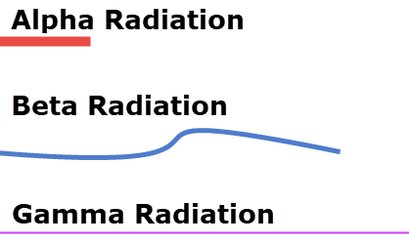
The different types of radioactive decay are named for the type of radiation that is given off during the nuclear decay reaction.
Alpha decay is a nuclear reaction in which an alpha particle is released from the nucleus.
Beta decay is a nuclear reaction in which a beta particle is released from the nucleus.
Gamma decay is a nuclear reaction in which gamma rays (alongside alpha or beta particles) are released from the nucleus.

Slide 5
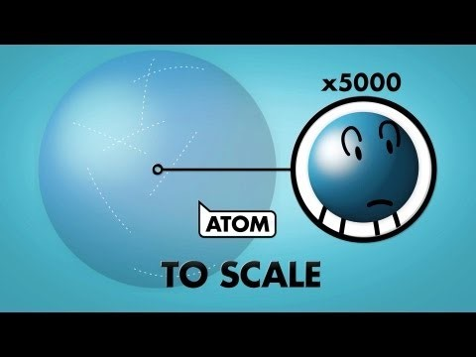

Slide 6
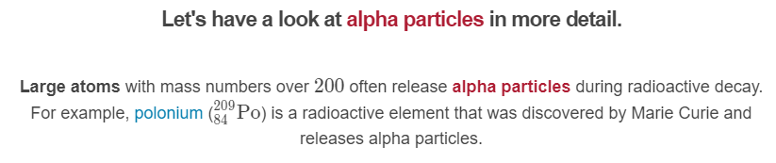
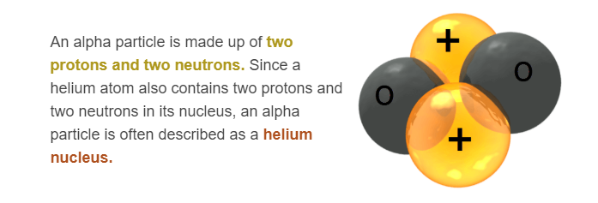

Slide 7

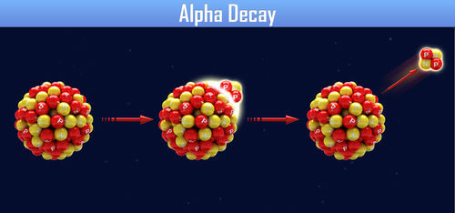
Since alpha particles are made up of two protons and two neutrons, they are positively charged.
The symbol for an alpha particle can be written in two different ways:

Slide 8
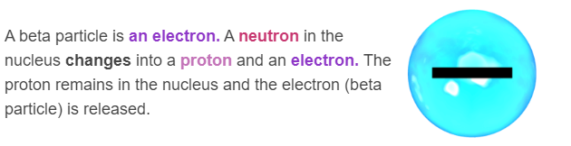
The second type of radiation is beta radiation.
Atoms that have too many neutrons often release beta particles during radioactive decay. For example, carbon-14 has 8 neutrons and 6 protons, so it releases a beta particle as it decays into nitrogen-14.

Slide 9

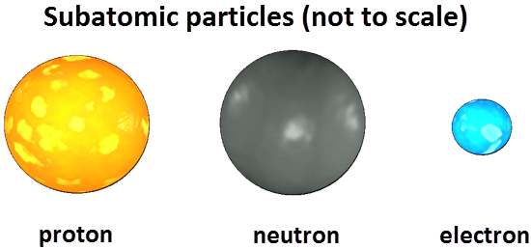
Because beta particles are electrons, they are negatively charged.
The symbol for a beta particle can be written in two different ways:
The mass of an electron is so small compared to protons and neutrons that it can be considered to be zero. Its charge is −1, which is written below the mass number in the symbol.

Slide 10
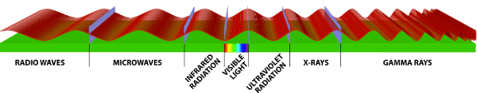
Many atoms release gamma rays at the same time as alpha and beta particles are released.
After alpha or beta particles are released, the nucleus may still be in a high energy state. Releasing a gamma ray lowers the energy of the nucleus again.
Gamma rays are not particles. They are electromagnetic waves. They have a very high frequency which means they are high energy.

Slide 11
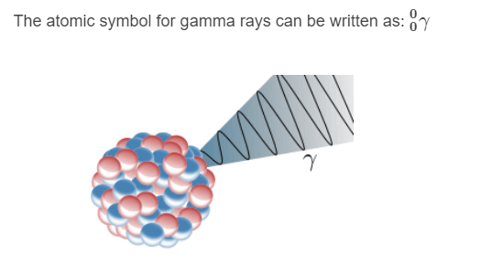
Since gamma rays are not particles but energy, they have no mass and no charge.

Slide 12
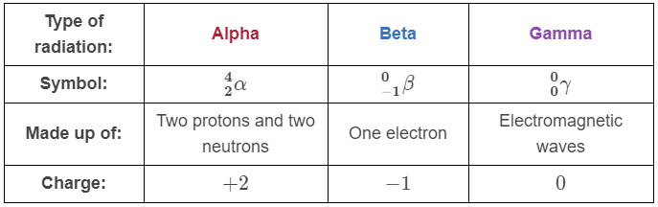
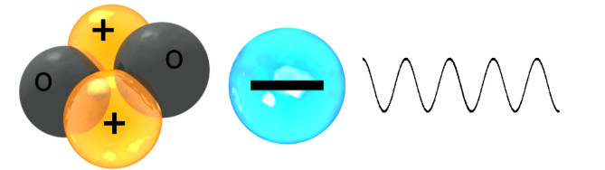
Here is a summary of the different types of radiation:

Slide 13

Alpha particles are made up of two protons and two neutrons, while beta particles are made up of one electron.
Since protons (which are the same size as neutrons) are about 1840 times larger than electrons, alpha particles are about 7400 times larger than beta particles.

Slide 14

As alpha particles are much larger than beta particles, they are also much slower.
Alpha particles move at about 5% the speed of light (about 16,000,000 m s⁻¹).

Slide 15
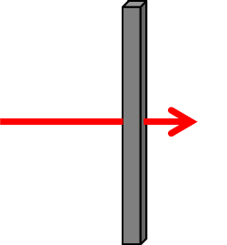
The ability of radiation to pass through materials is called its penetrating ability.
The penetrating ability of the different types of radiation depends mostly on the size of the particles.
The larger the particle is, the more likely it is to collide with atoms in the material it is passing through. Collisions with atoms stop the particles from moving through the material.

Slide 16

The size and speed of alpha particles means that they have low penetrating ability.
Alpha particles can be blocked by a few centimetres of air or a thin piece of paper. This means that if you had a lump of uranium-238, the alpha particles could be stopped by wrapping it in paper.

Slide 17

Beta particles are much smaller than alpha particles, so they move much faster.
Beta particles move at about 90% the speed of light (about 270,000,000 m s⁻¹).

Slide 18
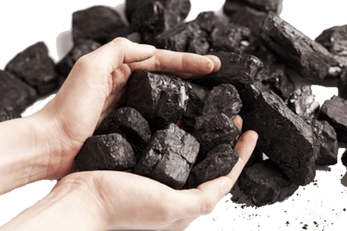
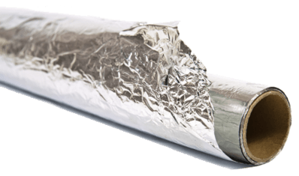
Beta particles have a moderate penetrating ability.
Beta particles can be blocked by a few metres of air or a thin sheet of aluminium.
This means that if you had a lump of carbon-14, the beta particles could be stopped by wrapping it in aluminium foil.

Slide 19

Gamma rays have no mass, so they move very fast.
Gamma rays move at the speed of light (300,000,000 m s⁻¹).

Slide 20
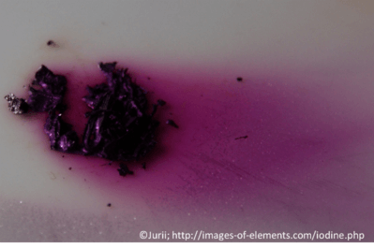

Gamma rays have a high penetrating ability.
Gamma rays can pass through many metres of air, and most of the gamma rays can be blocked by a thick layer of lead or concrete.
This means that if you had a lump of iodine-131, the gamma rays could be reduced by putting it in a lead box 10 cm thick, or inside a room with 1 m thick concrete walls.

Slide 21
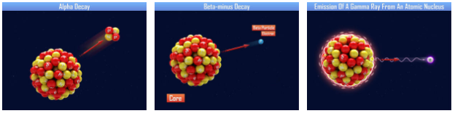
The different types of radiation have different ionising abilities.
Ionising ability is the ability of the radiation to knock electrons off other atoms or molecules.
The ionising ability depends on the mass and charge of the particle. The greater the mass and charge, the more easily it can knock electrons off. Therefore, the radiation is more ionising.

Slide 22
The ionising ability is inversely proportional to the penetrating ability.
This means that radiation with a greater ionising ability has a lower penetrating ability, and radiation with a lower ionising ability has a greater penetrating ability.
This is because each time the radiation collides with and ionises a particle in the material it is travelling through, it loses some of its energy.

Slide 23
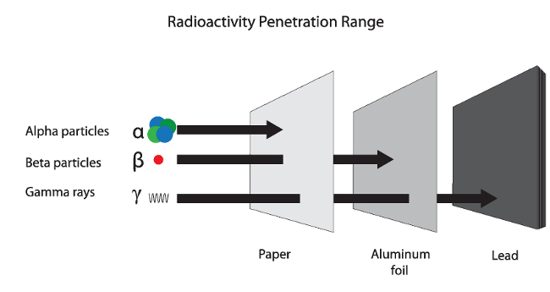
Alpha particles are large and have a charge of +2.
This means they have a very high ionising ability. Alpha particles do not penetrate very far through materials, which means the ionisation is localised to a small area. Alpha particles cause the most damage to living tissues.

Slide 24
Beta particles are much smaller than alpha particles, and they have a charge of -1.
This means it is more difficult for them to knock electrons off atoms or molecules, so they have a moderate ionising ability.
Beta particles can penetrate further through materials because their energy is not used up as quickly in collisions with particles. The effects of the ionisation are more spread out than for alpha particles, so beta particles cause less damage to living tissues.

Slide 25
Gamma rays have no mass and no charge, so they can penetrate a long way into matter before all their energy is used up in collisions.
This means they have a very low ionising ability. Gamma rays cause the least damage to living tissues out of these three types of radiation. However, they do still cause damage!

